Slide 1
Control Arm Simulations
ASEN 2003
Spring 2020

Slide 2
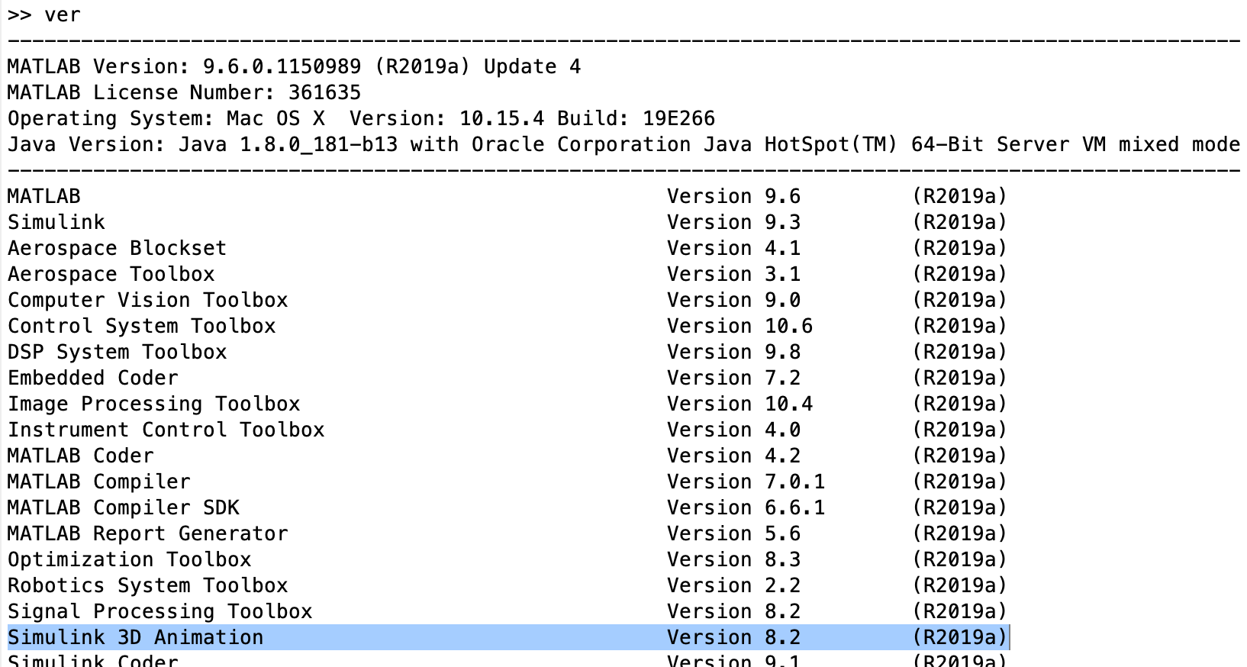
Install Simulink Animation 3D
Type ‘ver’ into MATLAB command prompt
If Simulink 3D Animation is installed skip this step.

Slide 3
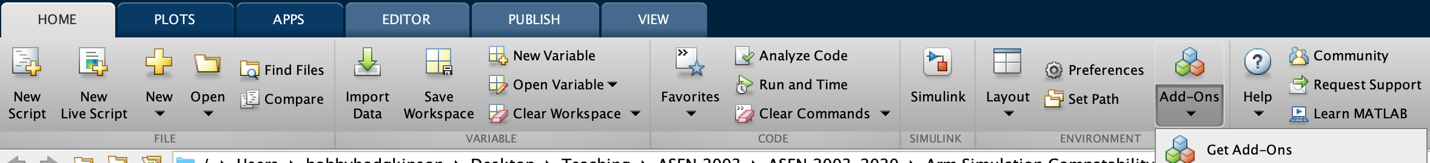
If Simulink 3D Animation is not installed..
Open Add-On Explorer
Home -> Add-ons -> Get add-ons
Search ‘Simulink 3D Animation’
Click install
Restart MATLAB

Slide 4
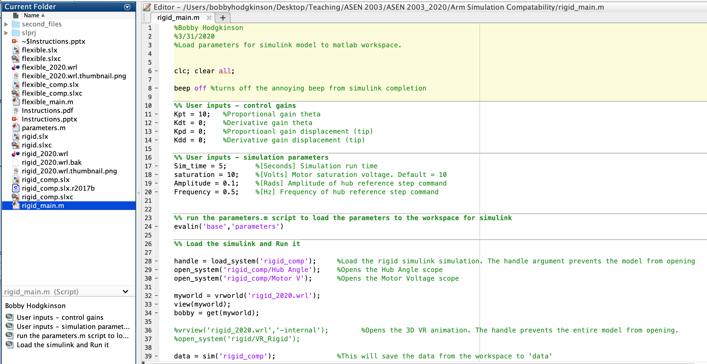
Open rigid_main.m

Slide 5
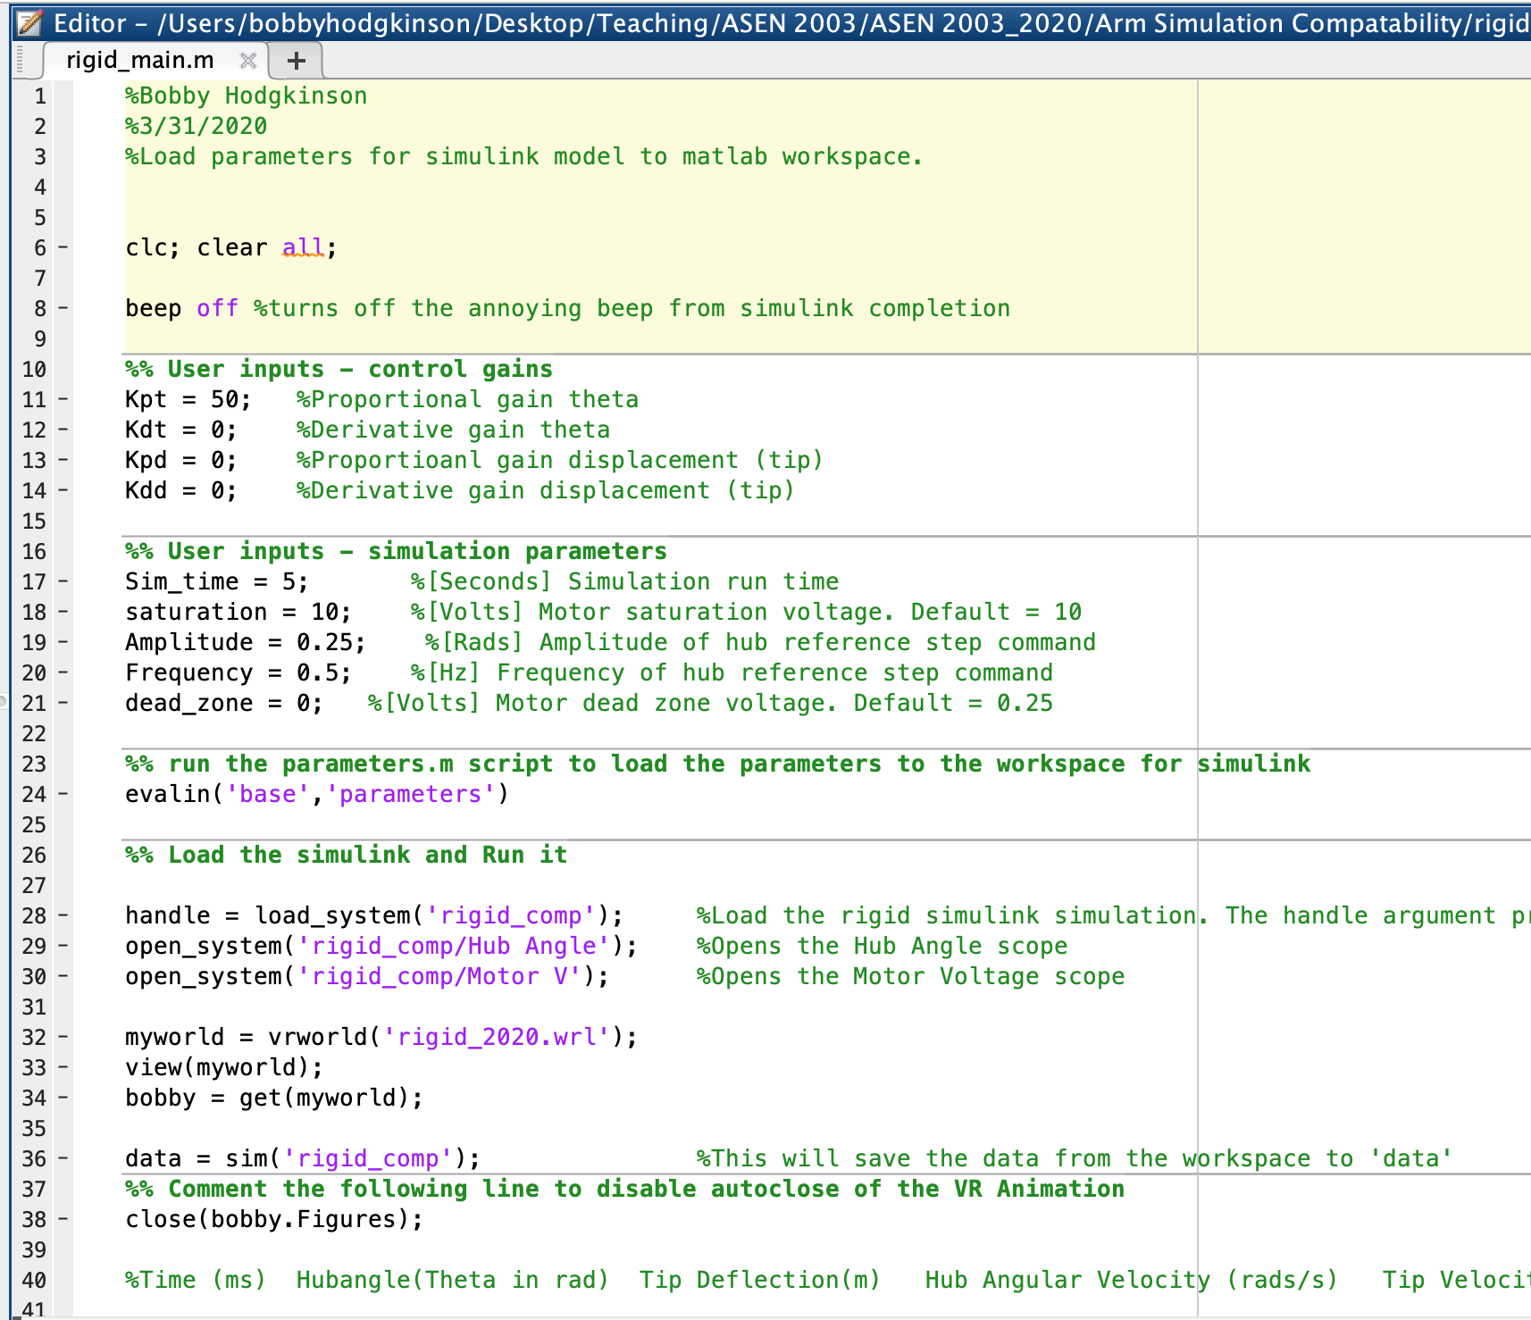
Input parameters
Control Gains. Change these as desired.
Simulation Parameters. Change these as desired
Simulation Calls. Change these if necessary

Slide 6
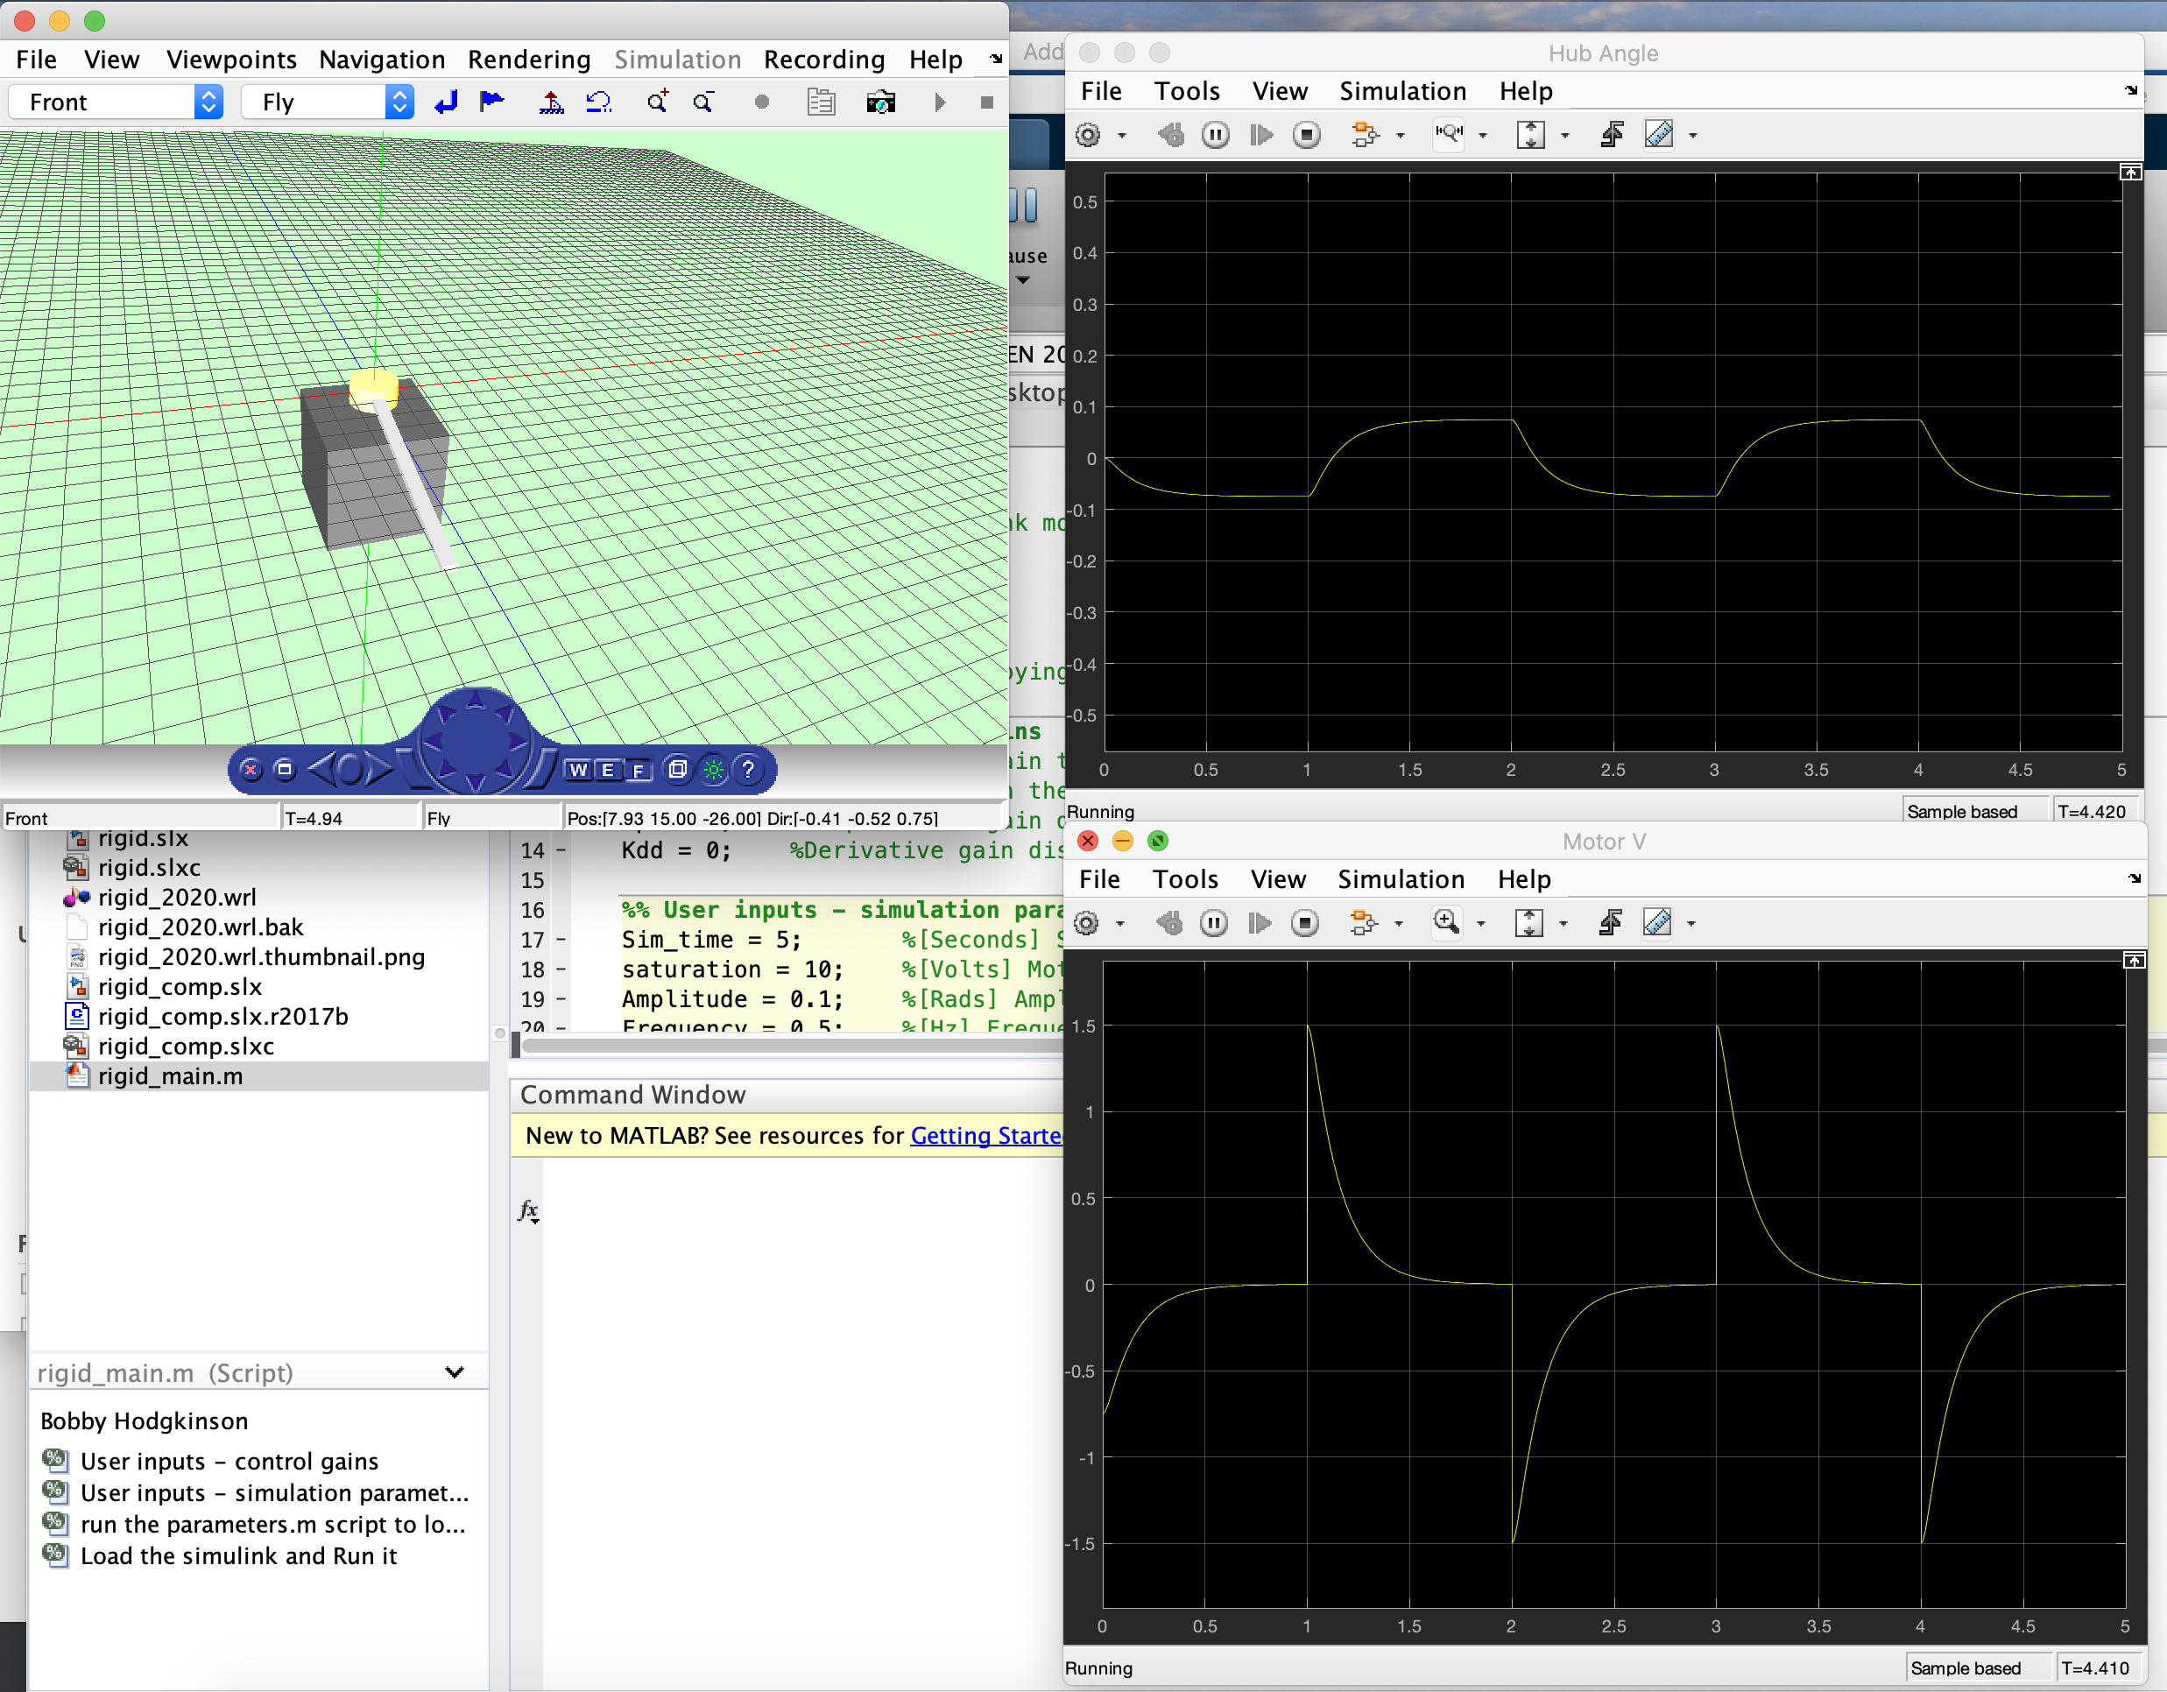
Click ‘run’
The simulation will run and display a plot of the Hub Angle and Motor Voltage as well as a 3D VR Animation

Slide 7
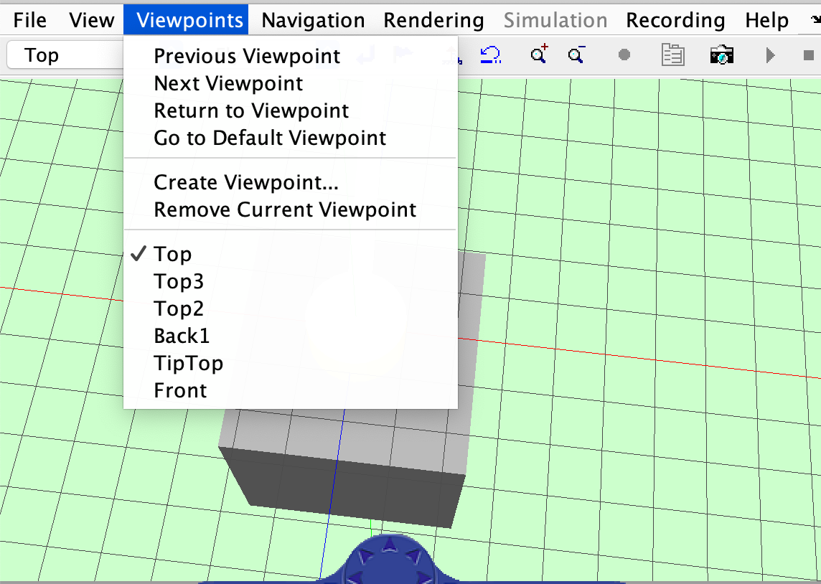
3D Animation and Change Viewpoint
The .m file automatically closes the 3D VR Animation after completion
Multiple runs will open multiple VR Animations unless manually closed
This slows down subsequent runs due to processor load
To disable the auto-close feature comment out the following line of code:
Change viewpoints by clicking ‘Viewpoints’
Select new viewpoint

Slide 8
Simulation Data
The variable ‘data’ contains experimental data from the simulation
Same format as the hardware experimental data
%Time(ms) Hubangle(Theta in rad) Tip Deflection (m) …
Access by data.simout.Data

Slide 9
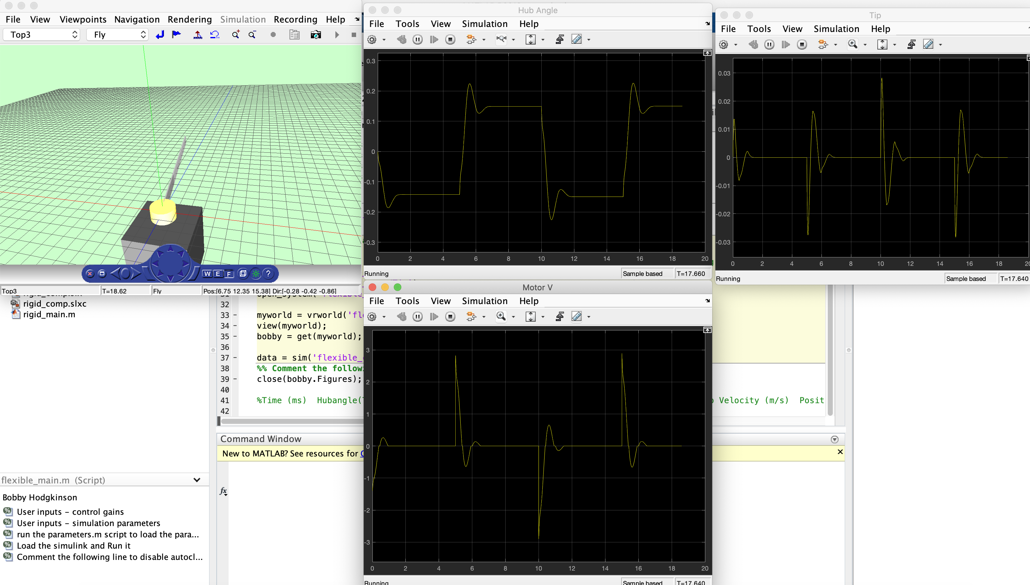
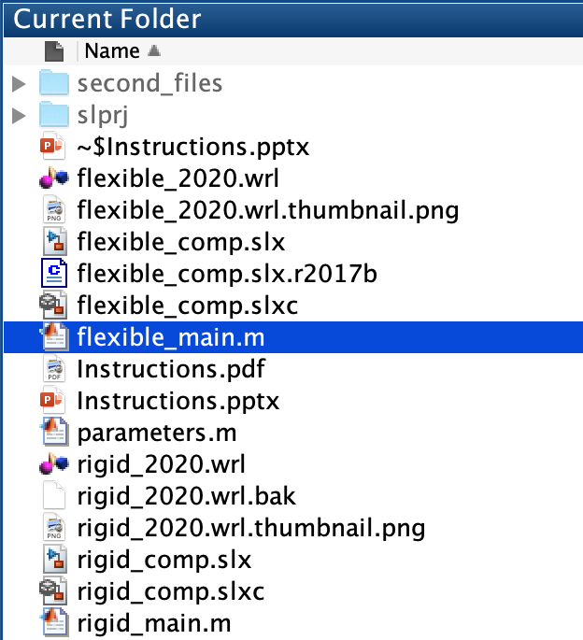
Flexible
Open flexible_main.m
Same procedure

